Slide 1
Indigènes
“Days of Glory”
FR 2031
09.17.21

Slide 2
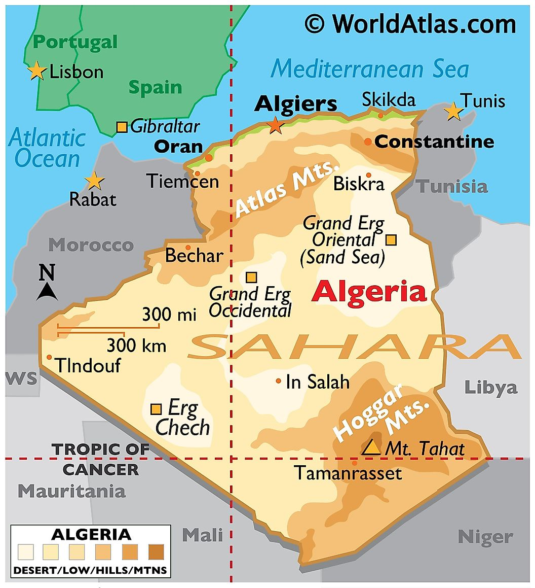
An Extremely Brief History of French Algeria (1830-1962)
France invaded in 1830
  Slow, bloody “pacification” process
  Periodic revolts – 1871 and 1916-17
Colonial society – Pied-noir (French settlers) and indigènes (condescending term for native Muslim population)
Several units served in WW I and WW II
Seen as integral part of France
  Decolonization provokes military putsch (1961)
Long & bloody war for independence (1954-62)
Extensive empire in West, North and East Africa
  Morocco (1912-56)
  Senegal (1659-1958)

Slide 3

Indigènes
Director – Rachid Bouchareb
Starring – Jamel Debbouze (co-producer & Saïd), Samy Naceri (Yassir, Moroccan), Sami Bouajila (Cpl. Abdelkader), Roschdy Zem (Messaoud), and Bernard Blancan (Sgt. Martinez, pied-noir)
Soundtrack – Armand Amar and Khaled
Budget - €14 million ($17 million USD)
Won 2006 Cannes Prix d'interprétation masculine and the César Award for Best Screenplay
Nominated for the Best Foreign Film Academy Award and several César awards, including Best Music

Slide 4
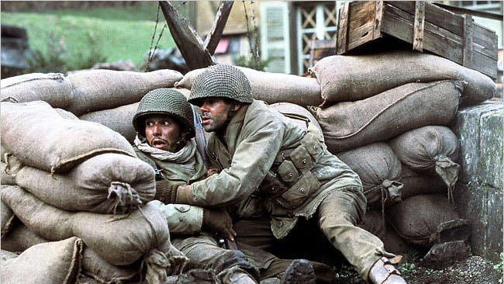
Indigènes
Fictional account of 7th RTA (7e Régiment de Tirailleurs Algériens)
  Based on veterans’ testimony
Algerian and Moroccan soldiers fighting in Italy and France (1943-45)
  Conflict with pied-noir and European French
  Colonial troops accounted for 60% of Free French forces (1944)
    134,000 Algerians and 73,000 Moroccans
Main themes are identity, patriotism, and discrimination
  Lack of promotions, leave, rations, and pensions
  Hypocrisy of “liberté, égalité, fraternité”

Slide 5
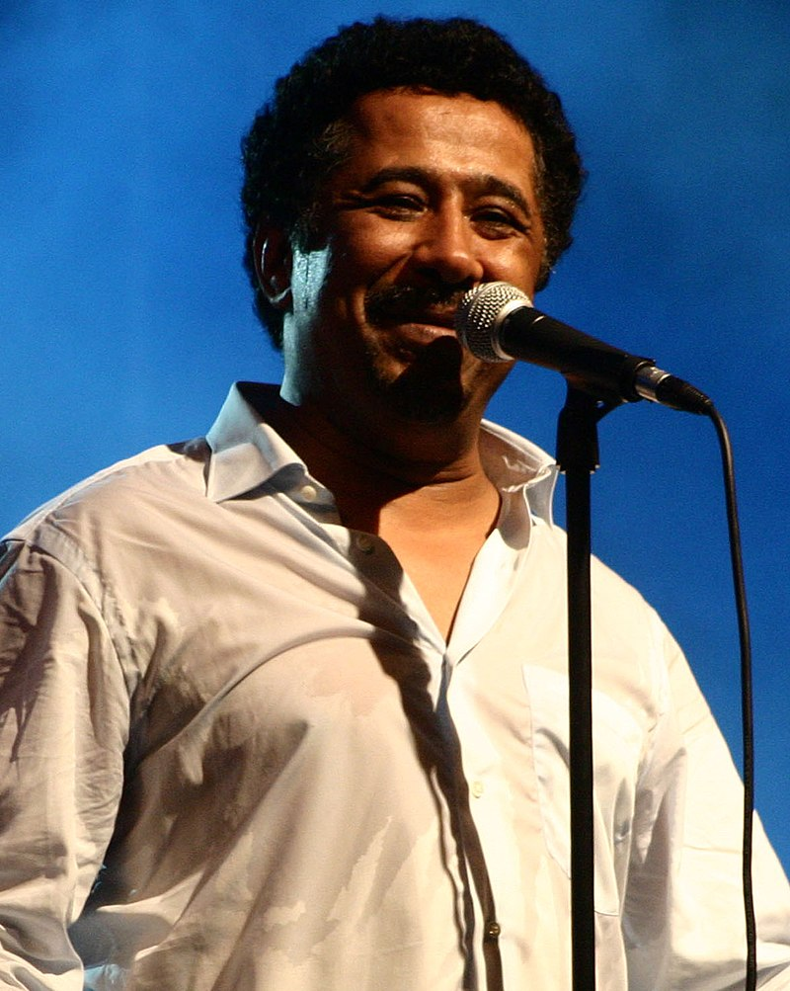
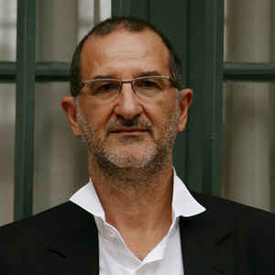
Soundtrack
Composer Armand Amar
  Dozens of film and TV soundtracks
  African and Middle Eastern influences
  Several César and IFMCA awards
Khaled Hadj Ibrahim
  Algerian folk singer
  80 million albums and numerous awards
Reinforces main themes of cultural identity and patriotism
Emotional cue and enhancer
Silence & natural ambiance

Slide 6
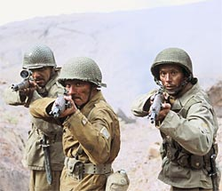
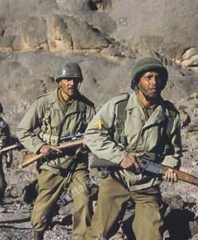
Selected scenes
1st- soldiers capture first objective in Italy (1943)
  Music accentuates and differentiates
  Commander ignores the casualties
  Jeep separates and “elevates” commander
2nd – Pied-noir sergeant and European captain try to resolve a protest over rations (1944)
  Captain struggles to label his own troops
  “La Marseillaise” unifies but also contradicts
  Diversity – Moroccans, Senegalese, etc.
3rd – Finale twists the emotional knife (2005)
  Similar to cemetery scene in Saving Pvt. Ryan (1998)
  Music stands in for character dialogue/monologue
  Film led Chirac to sign pension reform (but no arrears)
    €690 vs €61 ($815 USD vs. $72)

Slide 7
Questions? Comments?
Thank you!

